Slide 1
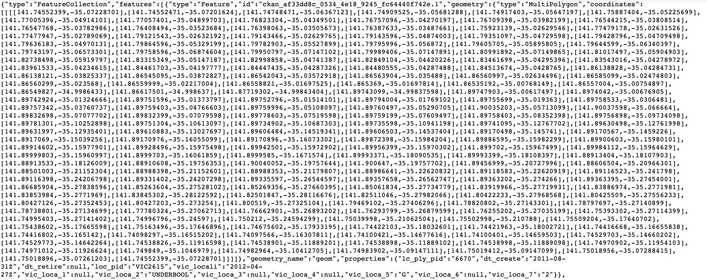
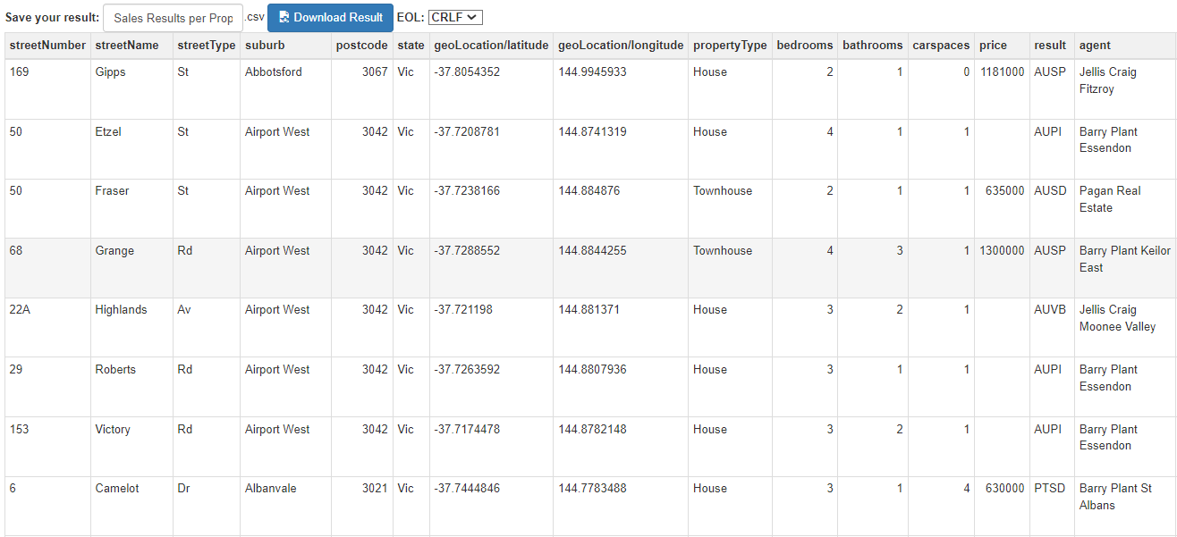
Data wrangling
How to display colours on the heatmap using geoJSON data
without quantitative data?
suburb
Coordinates: list of lists

Slide 2
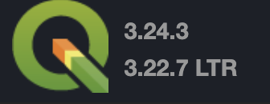
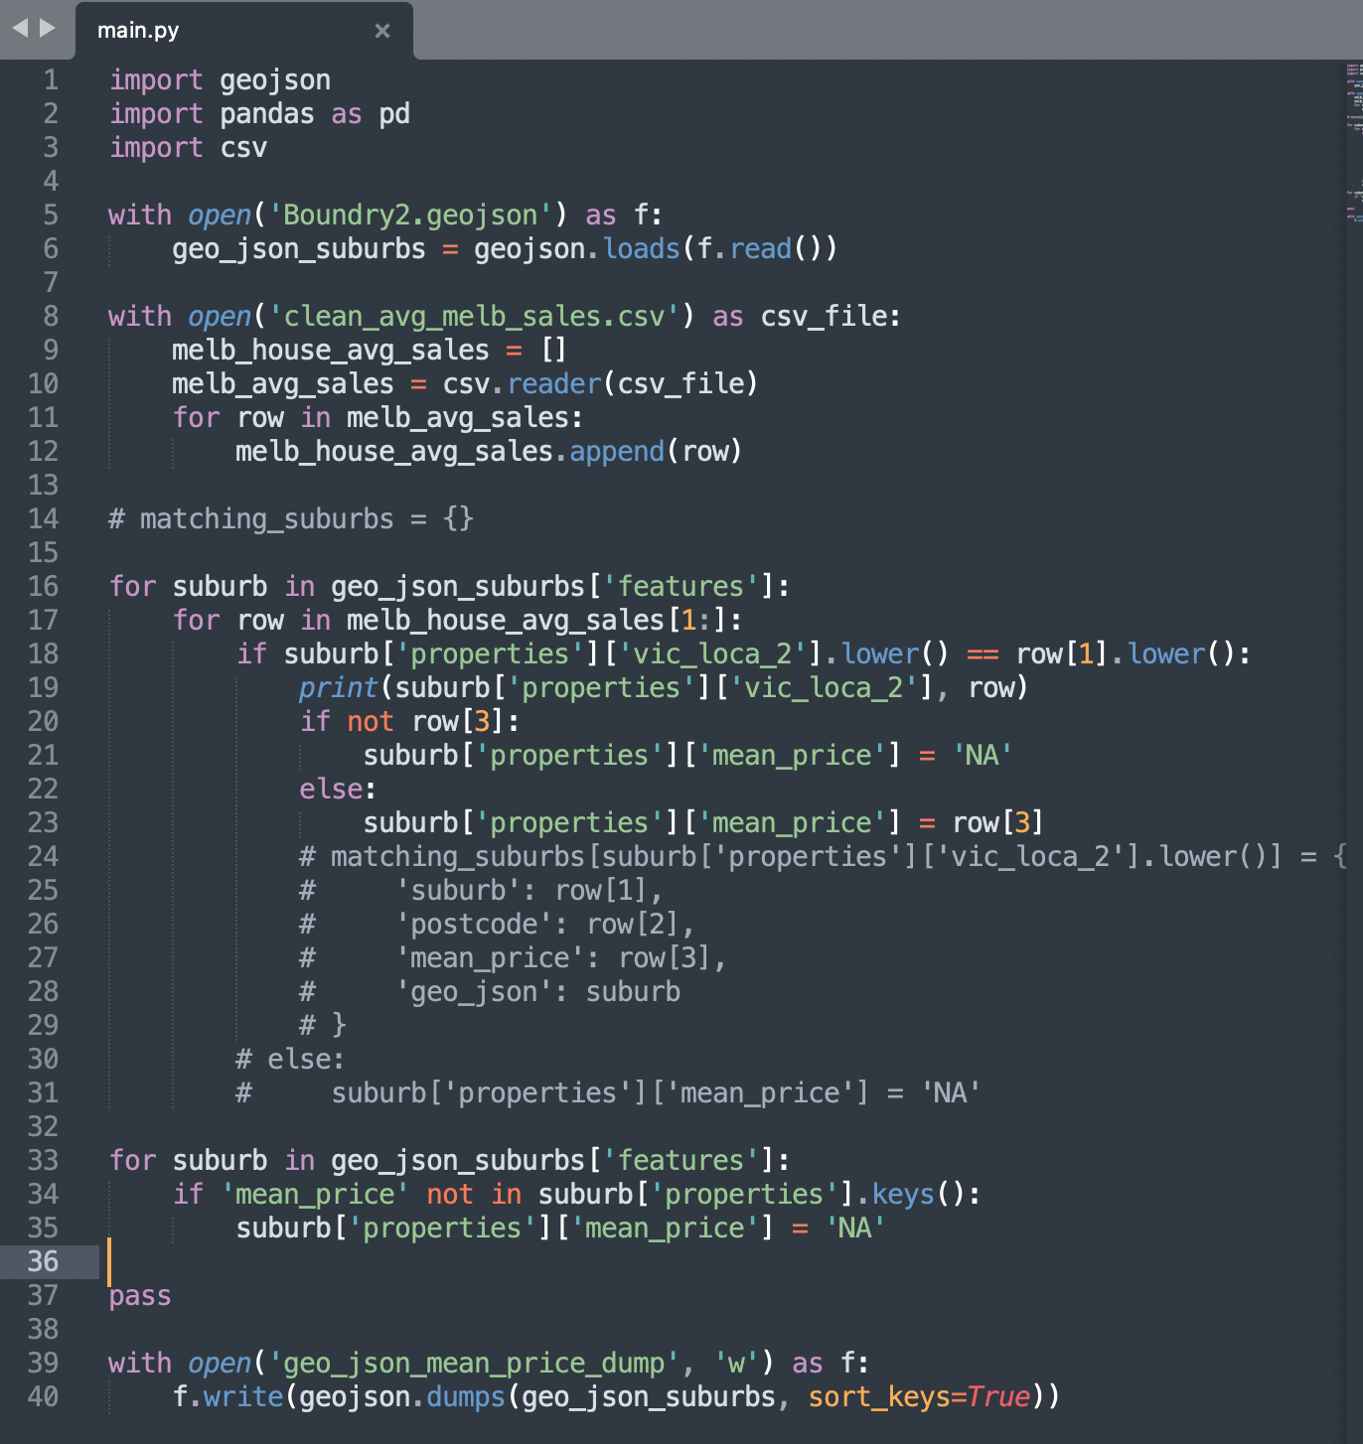
Merging geoJSON file with quantitate data -> not trivial
if number_of_rows in file_csv == number_of_rows in geoJSON:
print(“Go ahead use QGIS”)
if number_of_rows in file_csv != number_of_rows in geoJSON:
print(“prepare for sweating over coding”)

Slide 3
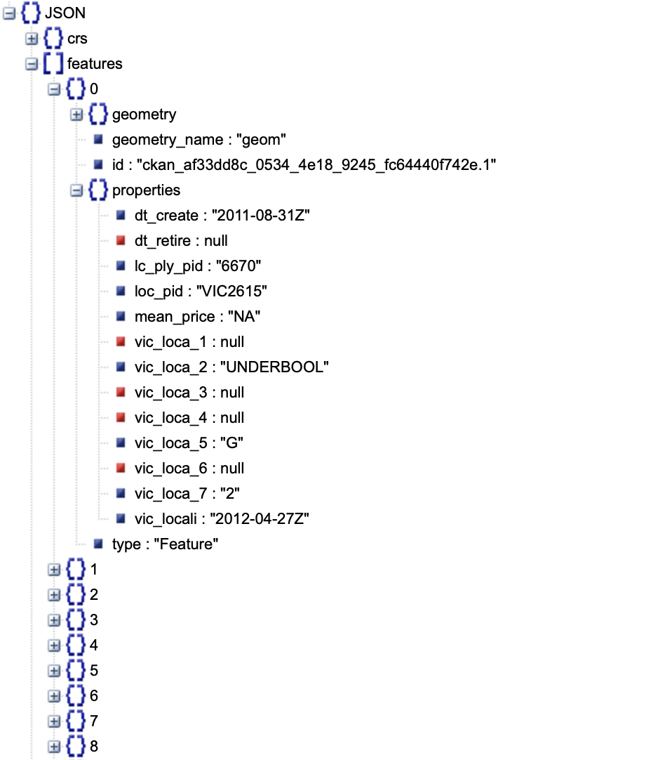
Chloropleth ready file
Polygon coordinates[coordinates]
Attribute value [mean_price]
Suburb [vic_loca_2]

Slide 4


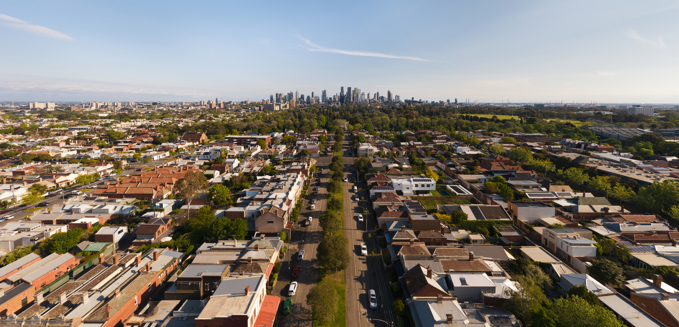
Which Melbourne suburbs made sales in the past week?

Slide 5
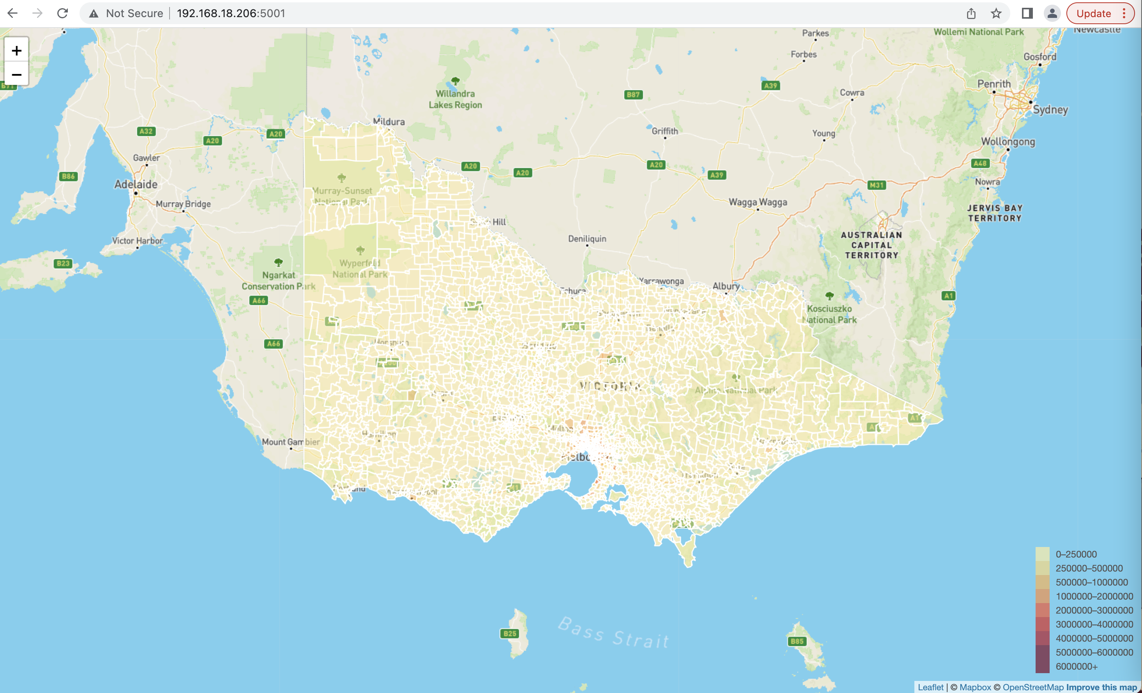
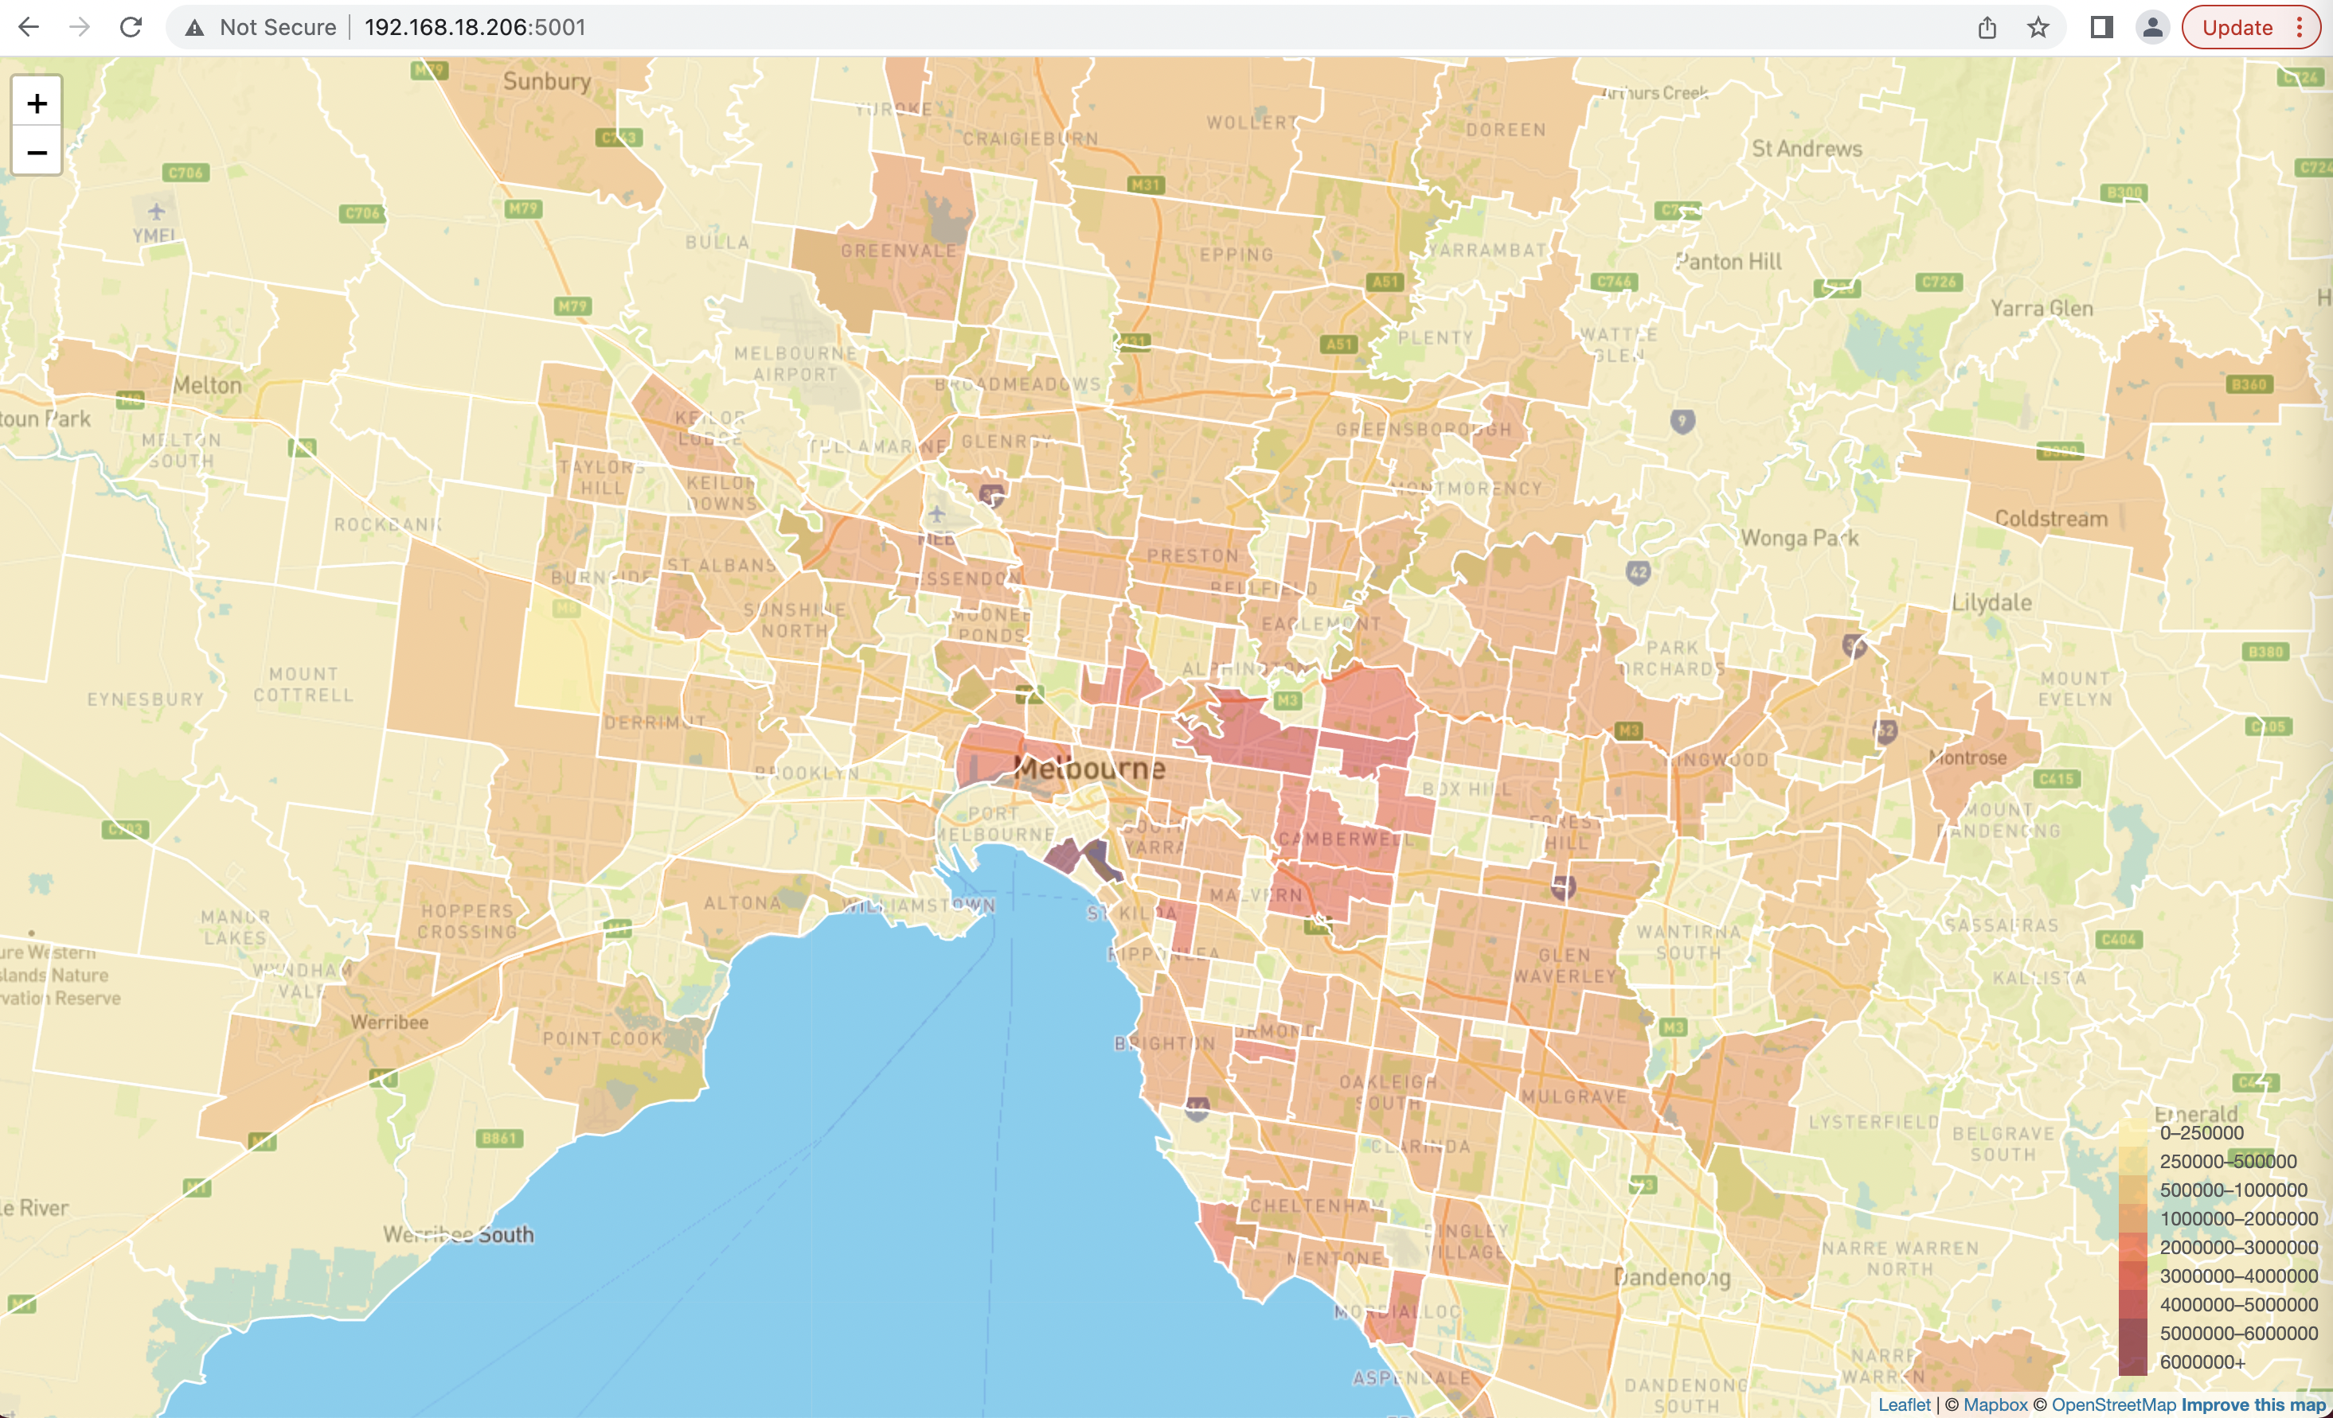
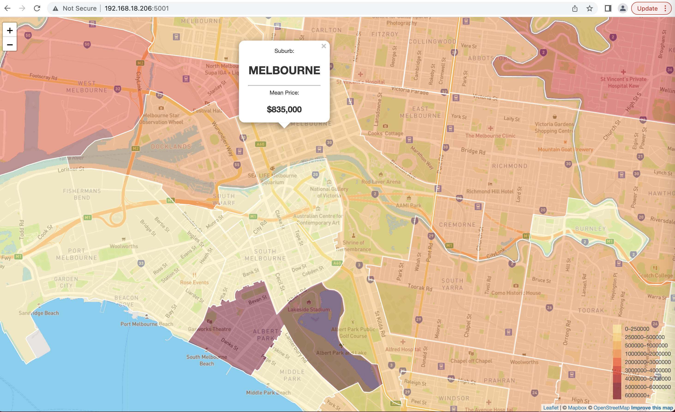
Displayed boundaries for nearly 3000 suburbs in Victoria
Heatmap representing the varying prices across the suburbs
Interactive visualization of median prices
Heatmap legend

Slide 6
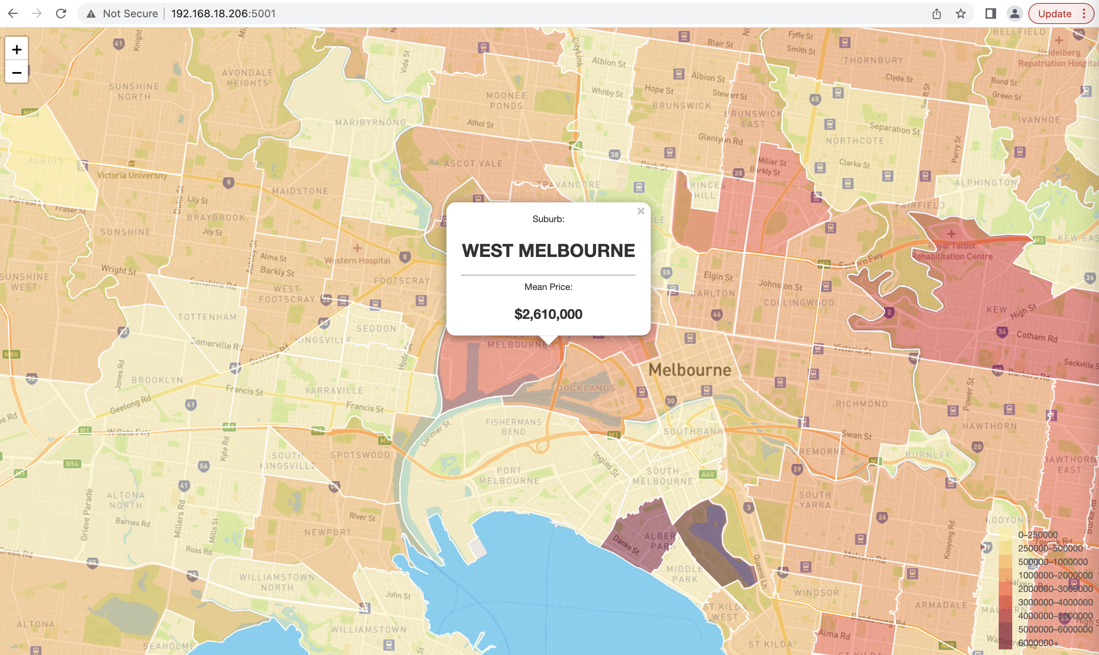
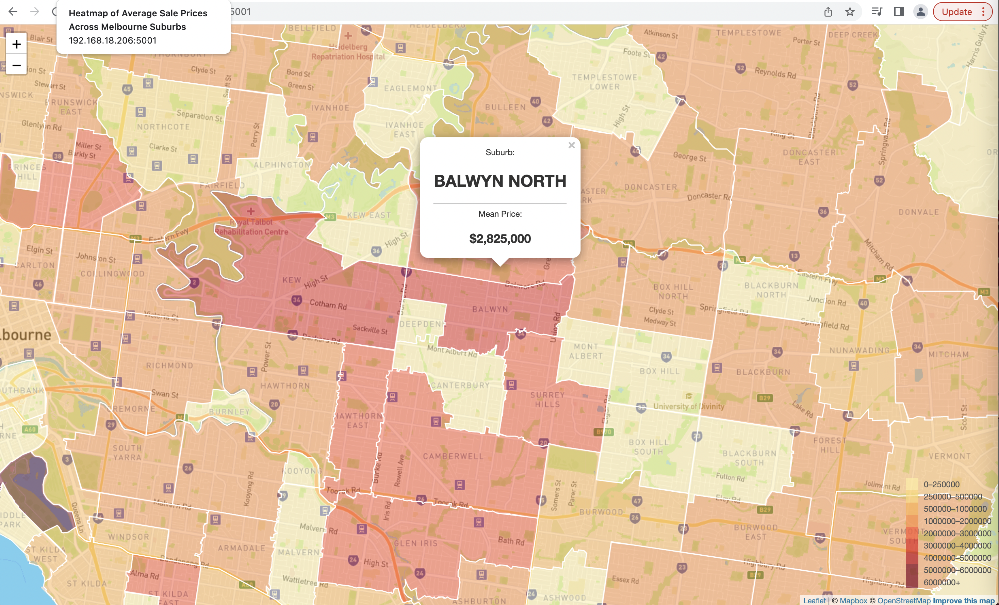
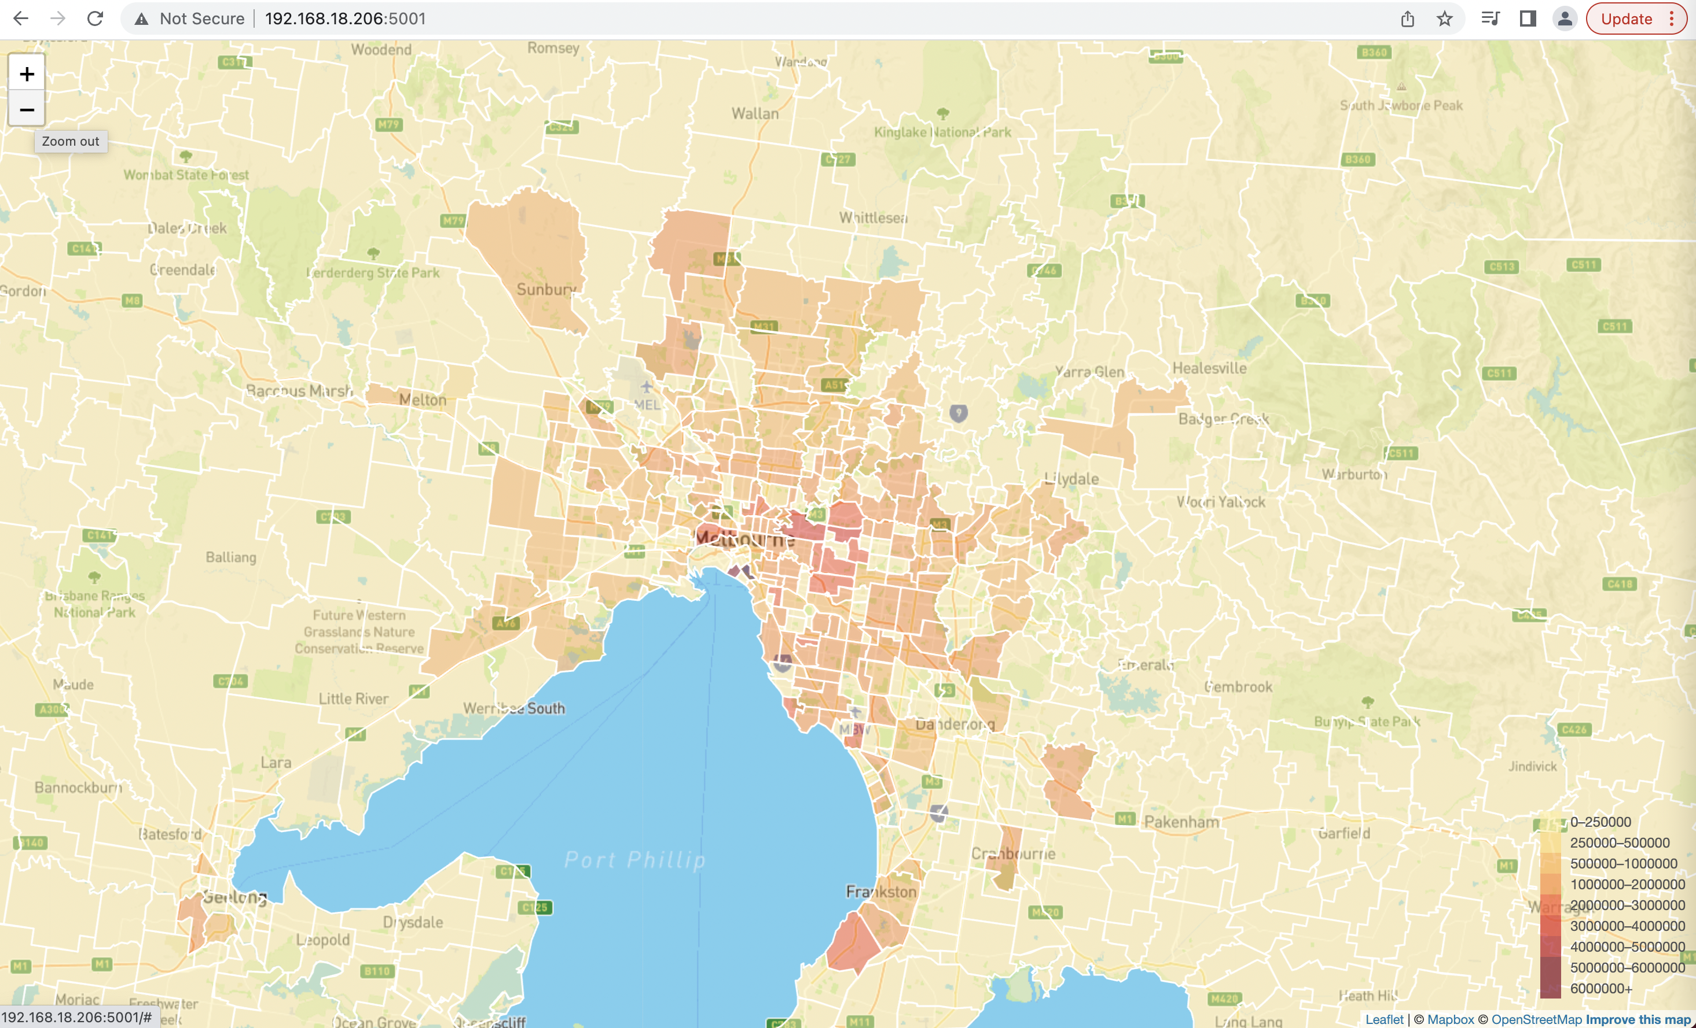
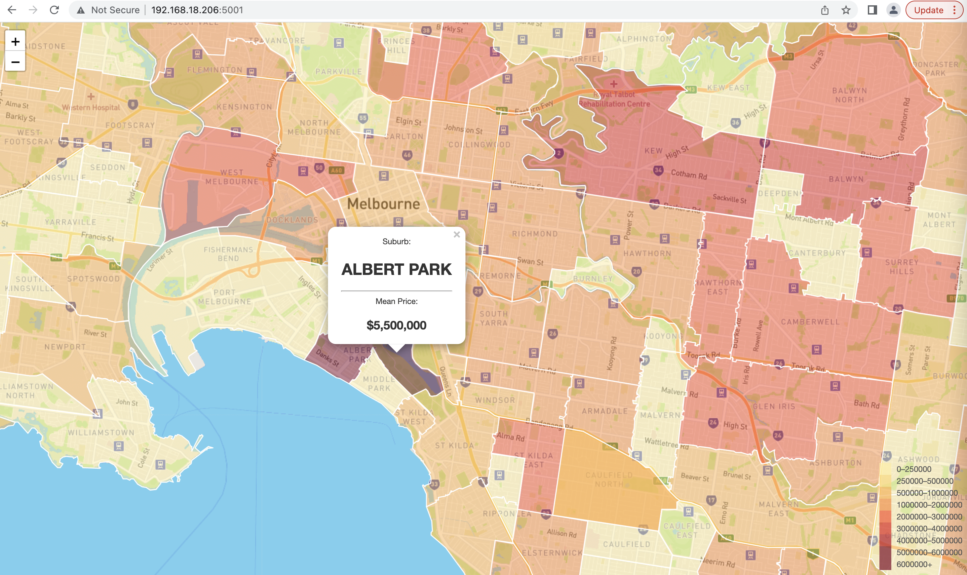
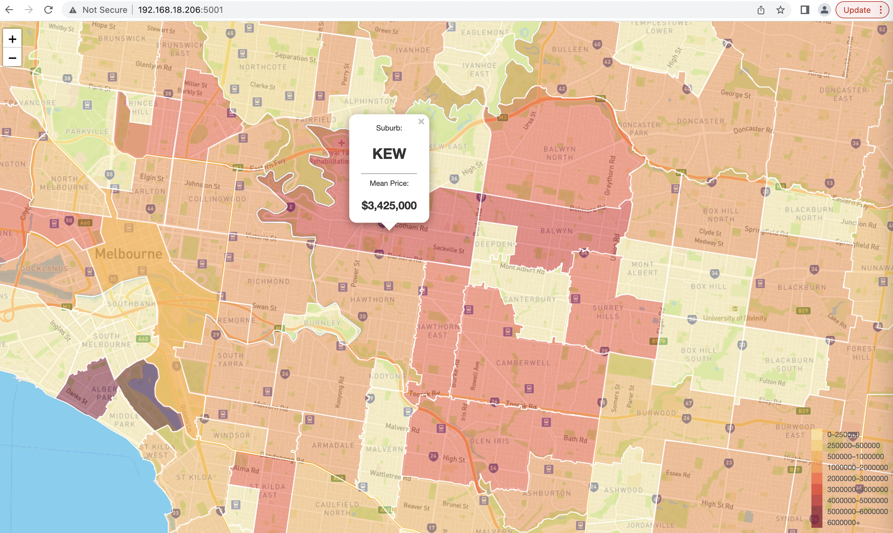
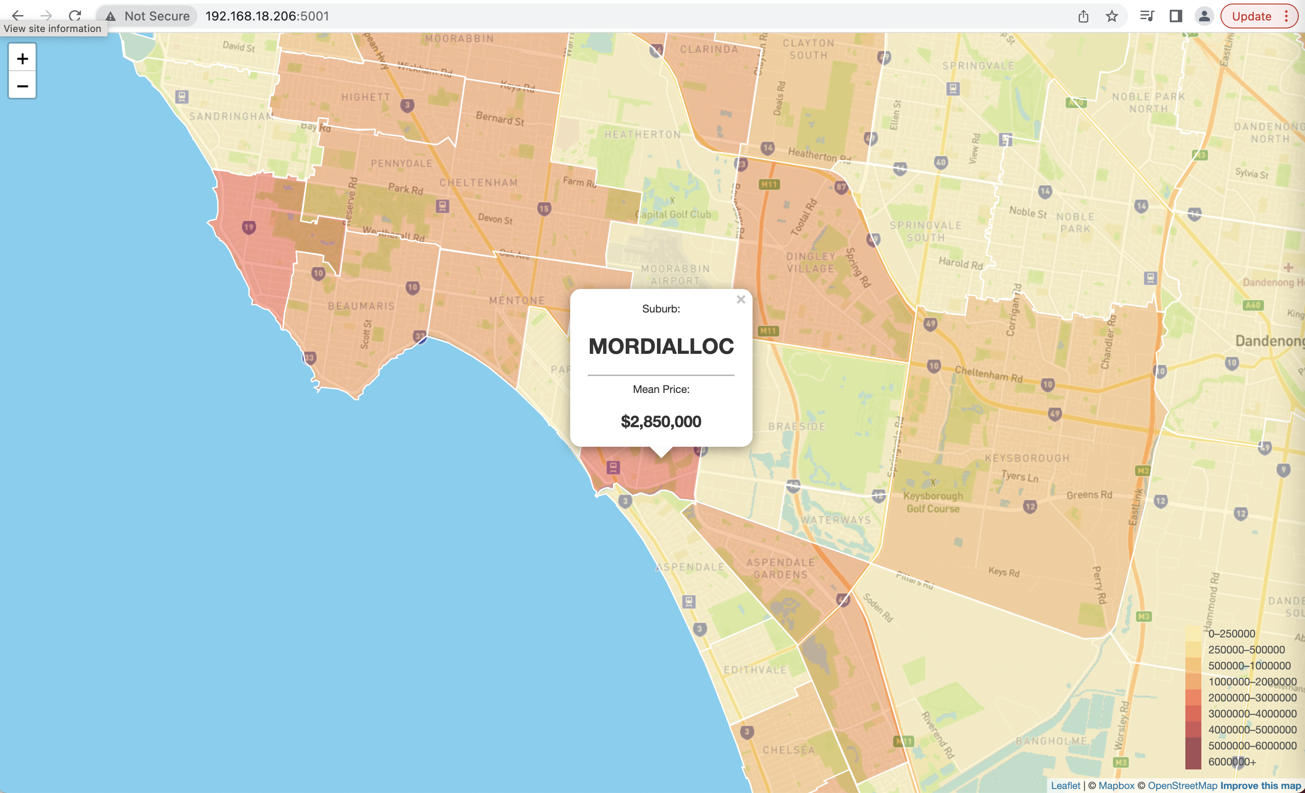
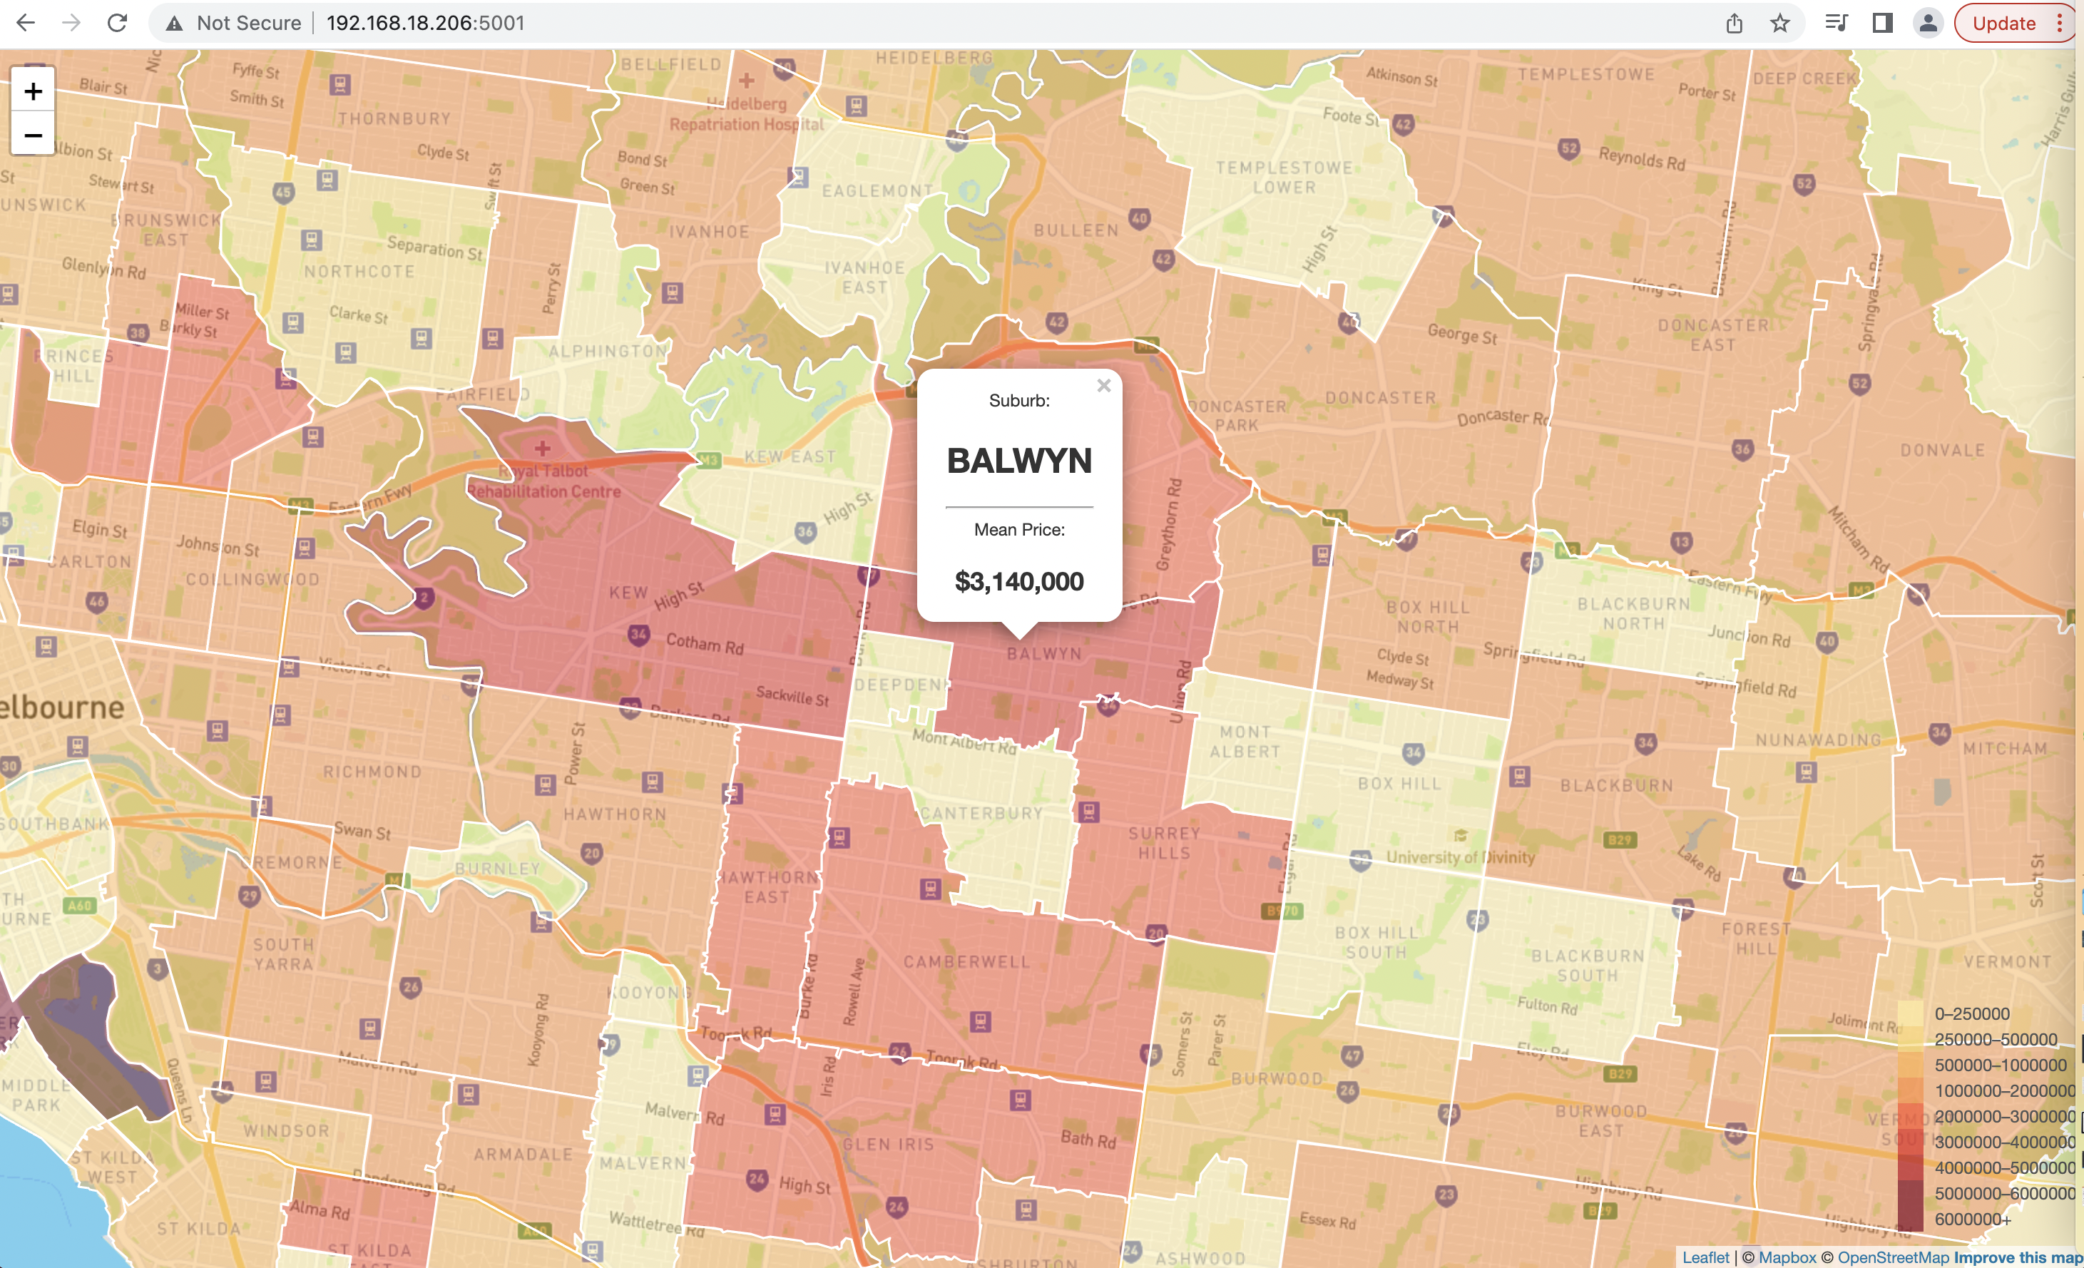
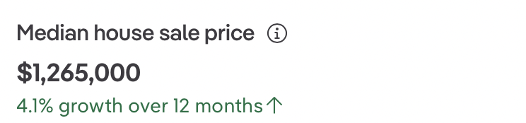
Findings:
Inner Melbourne suburbs sold most properties vs outskirts
Top 5 most expensive suburbs:
Albert Park $5,500,000
Kew $3,425,000
Balwyn $3,140,000
Mordialloc $2,850,000
Balwyn North $2,825,000
Hot spot:
West Melbourne $2,610,000

Slide 7
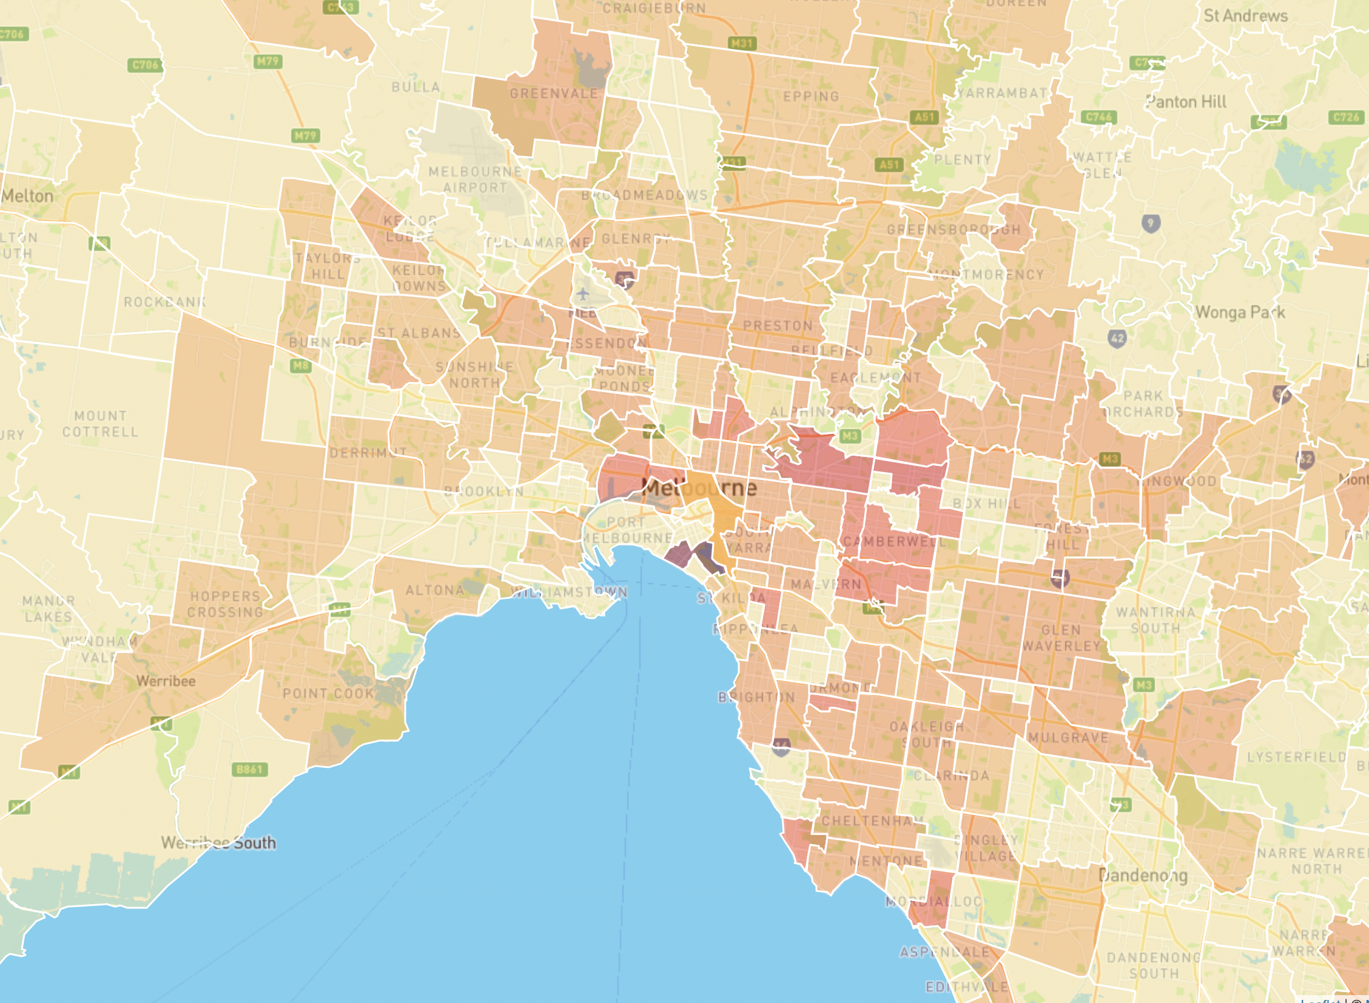
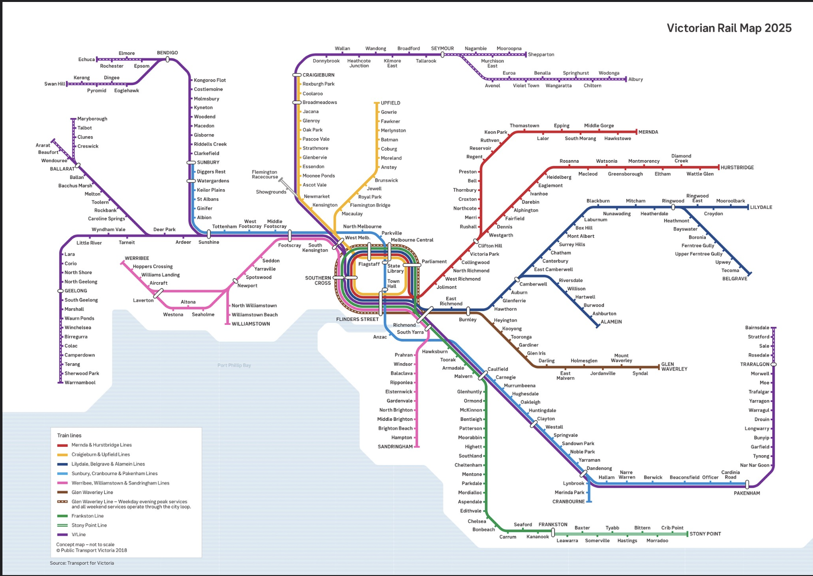
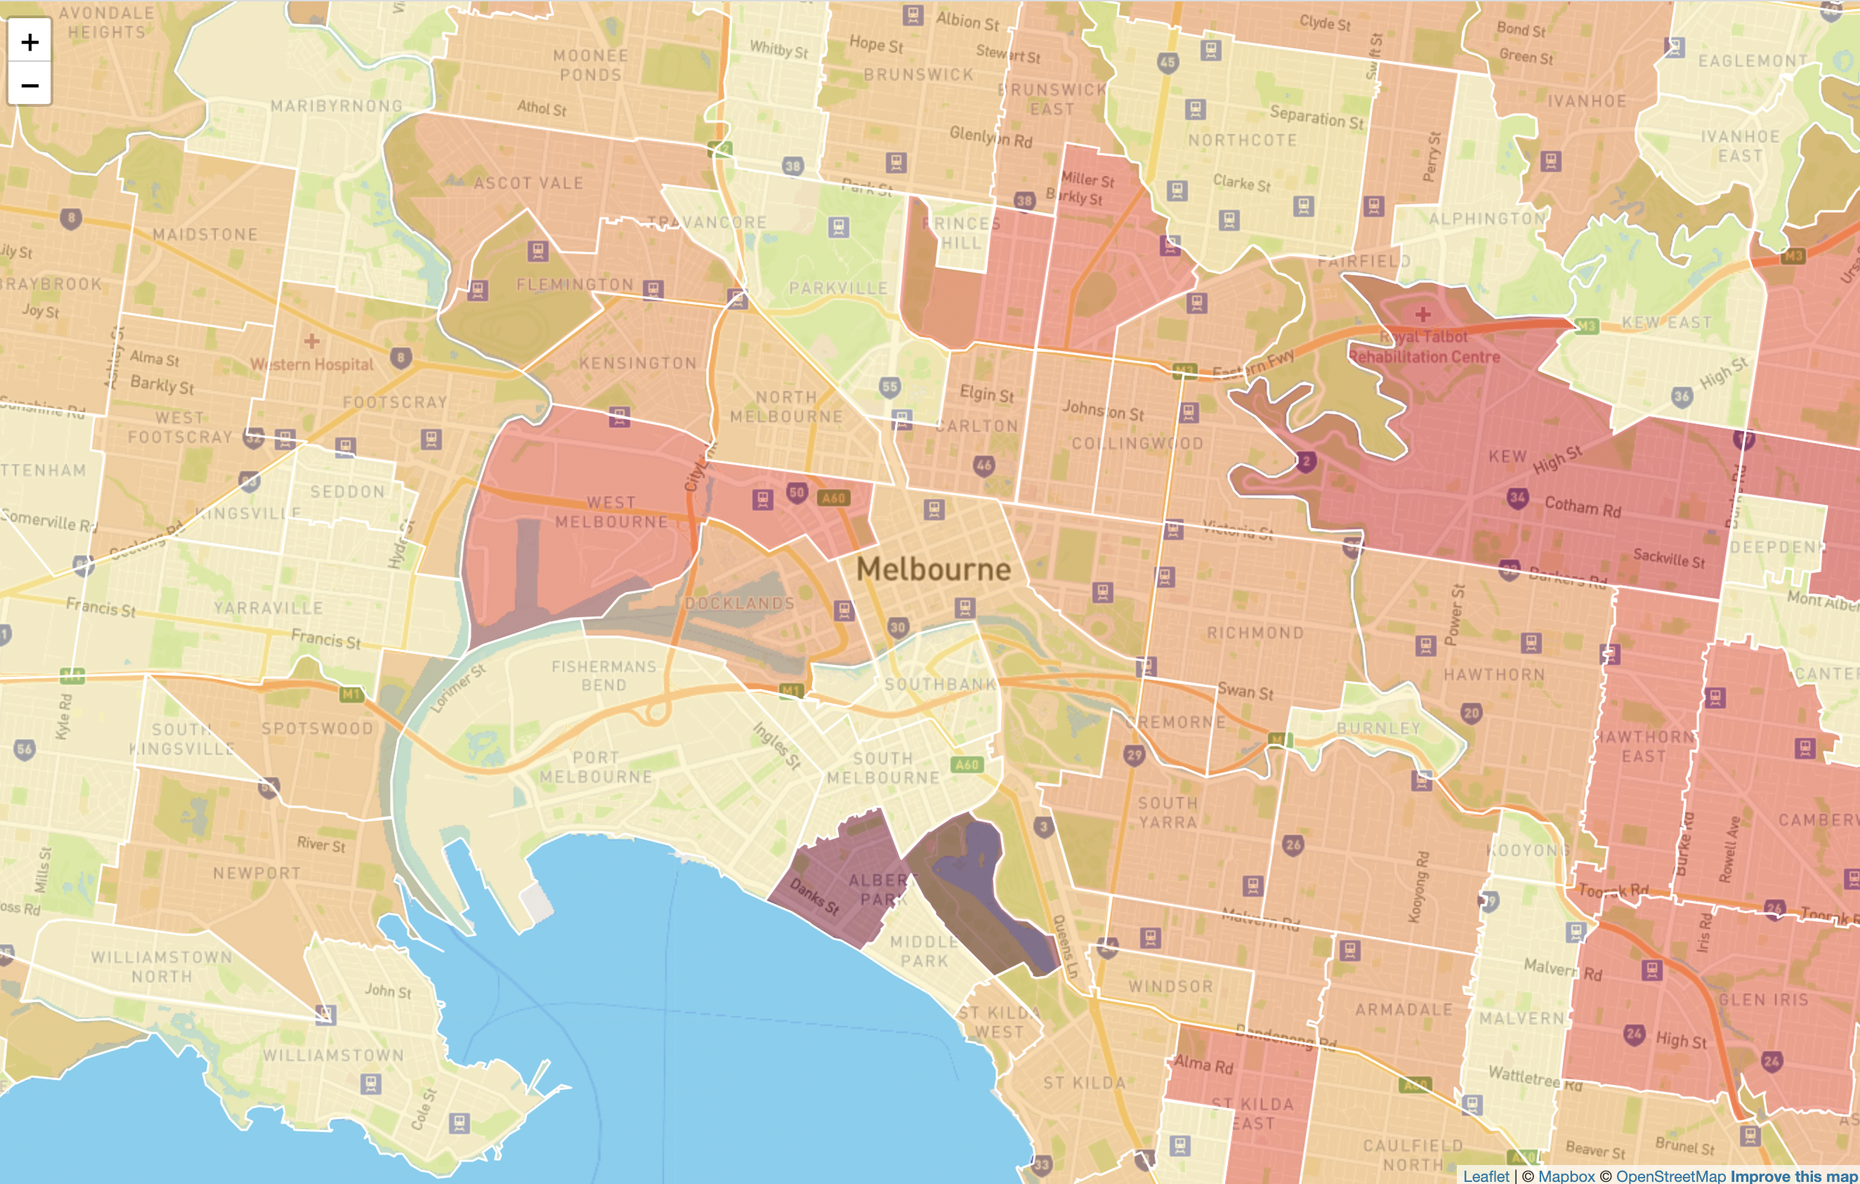

Does transport network and plans of improvements make suburb more desirable?

